Slide 1
A Mentor’s Influence on the Missionary Call
by David P. Jacob, Director of the Center for Missionary Mobilization and Retention

Slide 2
Mobilizing vs. Recruiting
These terms may mean different things to different agencies. For some, mobilization is the process of helping someone: 1) become interested in missions and 2) discover their role in the missions endeavor. The term recruitment for these agencies is finding someone who has already been mobilized and encouraging them to join their agency.
For other agencies, the term mobilization refers to helping those already accepted to the agency get to the field. For them, recruitment is the similar to the above: finding someone who is already interested in serving as a missionary and encouraging them to join their agency.

Slide 3
Missions Mentoring
Whether you refer to the beginning process as mobilization or recruitment, when we talk about missions mentoring, we are referring to the process of helping someone: 1) become interested in missions and 2) discover their role in the missions endeavor.

Slide 4
The Problem
“Nancy Bridgeman, director of Student Mission Advance of Hamilton, Ontario, made this early claim that ‘only two or three out of every 100 who undertake to go to the mission field actually set out…’” — Holzmann, J. (1988, March). “Short Terms,” Missions Frontiers Bulletin.
“For every missionary who goes to the foreign mission field, there are at least fifty individuals who at one time or another committed their lives to missions, but never carried through with their commitment.” — Ruth A. Tucker From Jerusalem to Irian Jaya, (pg. 480).

Slide 5
Common Barriers
Fear
Debt/Finances
Theological Drift
Family
Lack of Spiritual Formation
Confusing Definitions

Slide 6
A Mentor’s Influence Produces…
Direction
Spiritual Formation
Character Development
Education
Assurance
“A student will rarely make the decision to become a [missionary] without the committed and consistent input of a few trusted individuals.”
— Ryan Shaw

Slide 7
Direction
What’s God’s will for my life?
Information Overload
Authenticity/Transparency
Called at Bible Camp

Slide 8
Spiritual Formation
Teenage Faith Drift (see Kara Powell’s article, “Preventing Teenage Faith Drift” in Christianity Today)
Prayer & Bible Study
Disciple-ize
Accountability
Caught & Taught

Slide 9
Character Development
Resilience/Grit
Flexibility
Positive Attitude
Humility
Followership

Slide 10
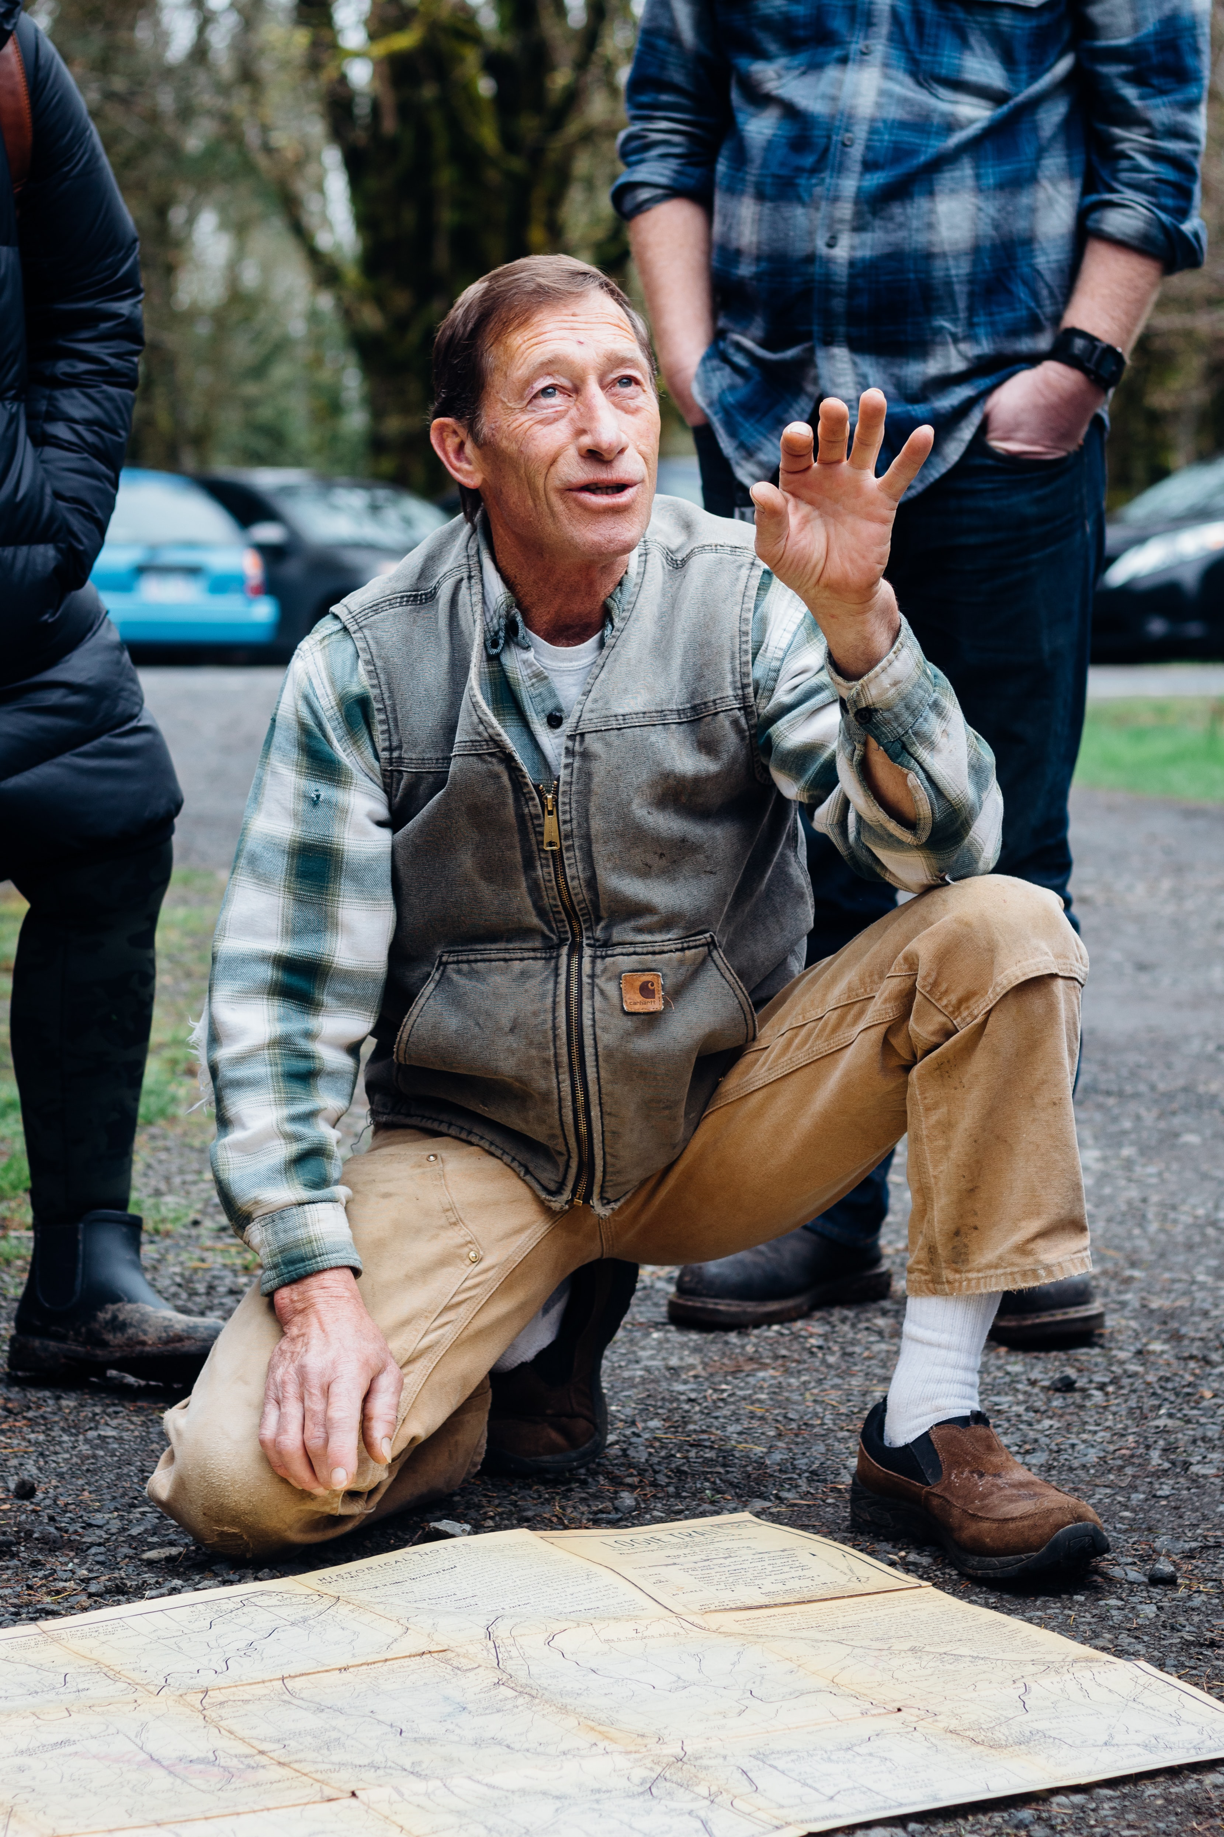
Education
Confusing Definitions
Correct Doctrine
Recommending Resources: Books, Websites, Apps, Videos, Podcasts
Budgeting
Missionary Stories

Slide 11
Assurance
Sense of Inadequacy
Positive Reinforcement
Safe Space
Unknowns
Overcoming Fears

Slide 12
Further Resources

Slide 13
Questions for Discussion
Should formal mentorship programs be established? If so, how and with whom?
Should missionaries be trained on how to mentor others? If so, how?
How can we better facilitate organic mentoring relationships?

Slide 14
Connect
Contact me: djacob@trinitybiblecollege.edu
missionarymobilization.org
Facebook & Instagram: @missionarymobilization
Twitter: @missionmobilize
LinkedIn: The Center for Missionary Mobilization & Retention

